Slide 1
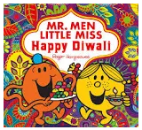


Autumn Year 1
Celebrations of lights

Slide 2

Spring 1 Year 2
What is a Sikh family like?

Slide 3
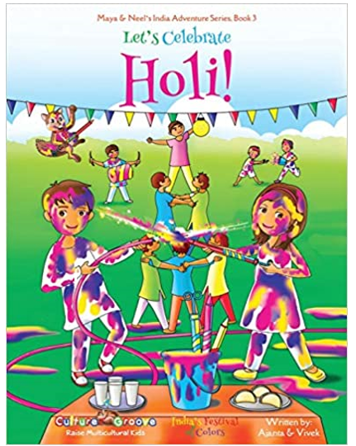
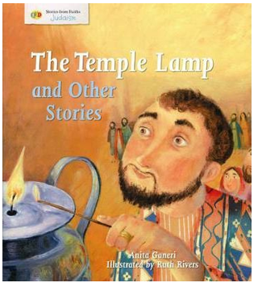
Summer Year 3
Why is light important in different faiths?

Slide 4


Summer unit Year 4
How do we care for our world?

Slide 5

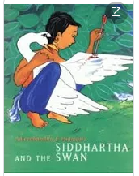
Autumn Year 5
Who are Buddhists?

Slide 6

Spring Year 6
What do different faiths think about death?

